Slide 1
CCE201: Solid State Electronic Devices
EEC223: Electronics (1)
Lecture 09 Field Effect Transistors (2)
Prepared By
Dr. Eng. Sherif Hekal
Assistant Professor, CCE department

Slide 2
Introduction
IN THIS LECTURE WE WILL LEARN
How the transistor can be used to make an amplifier, and how it can be used as a switch in digital circuits.
How to obtain linear amplification from the fundamentally nonlinear MOS transistor.

Slide 3
3. MOSFET Circuits at DC
We move on to discuss how MOSFET’s behave in dc circuits.
We will neglect the effects of channel length modulation (assuming λ = 0).
We will work in terms of overdrive voltage (v_{OV}), which reduces need to distinguish between PMOS and NMOS.
DC

Slide 4
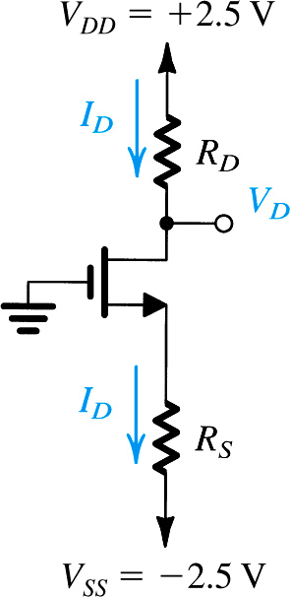
Example 1: NMOS Transistor
Problem Statement: Design the circuit of the figure shown, that is, determine the values of R_{D} and R_{S} – so that the transistor operates at I_{D} = 0.4mA and V_{D} = +0.5V. The NMOS transistor has V_{t} = 0.7V, μ_{n}C_{ox} = 100μA/V², L = 1μm, and W = 32μm. Neglect the channel-length modulation effect (i. e. assume that λ = 0).

Slide 5
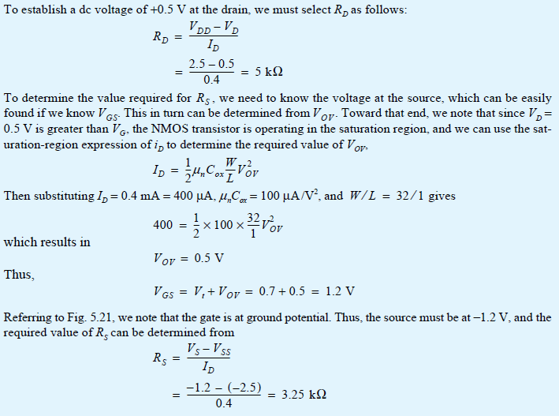
Example 1 - Sol

Slide 6
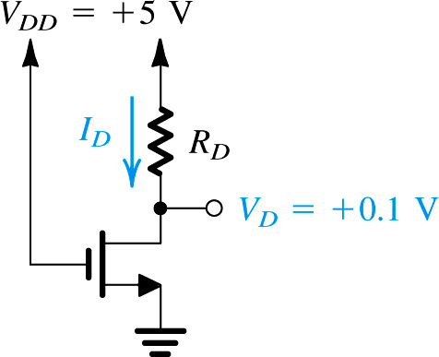
Example 2: MOSFET
Problem Statement: Design the circuit in Figure to establish a drain voltage of 0.1V. What is the effective resistance between drain and source at this operating point? Let V_{tn} = 1V and k’_{n}(W/L) = 1mA/V².

Slide 7
Example 2 - Sol

Slide 8
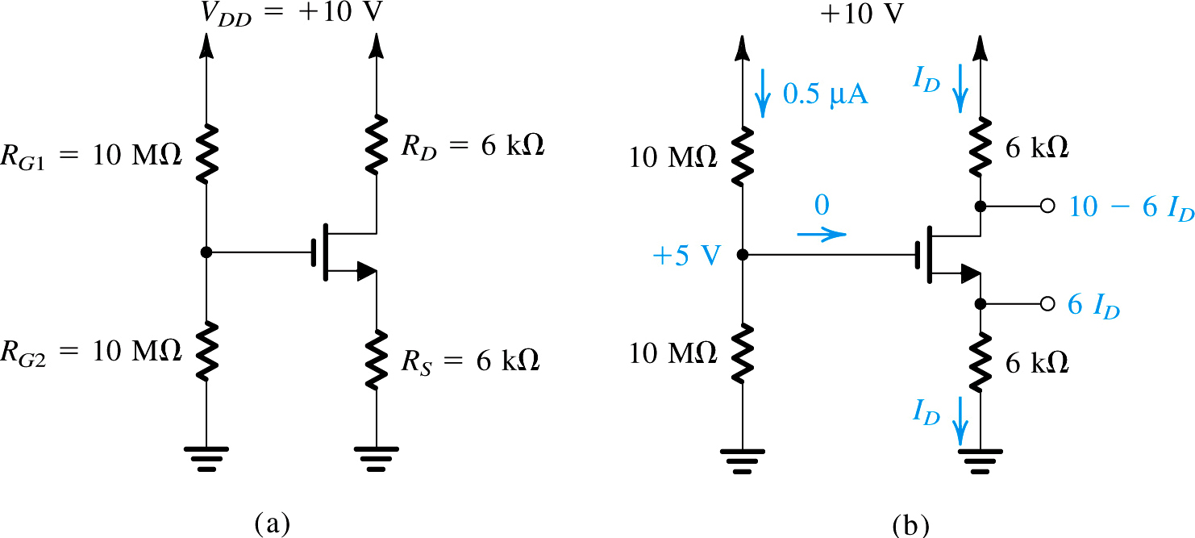
Example 3: MOSFET
Problem Statement: Analyze the circuit shown in Figure(a) below to determine the voltages at all nodes and the current through all branches. Let V_{tn} = 1V and k’_{n}(W/L) = 1mA/V². Neglect the channel-length modulation effect (i.e. assume λ = 0).

Slide 9
Example 3 - Sol
With this positive voltage at the gate, the NMOS transistor will be turned on. We do not know, however, whether the transistor will be operating in the saturation region or in the triode region. We shall assume saturation-region operation, solve the problem, and then check the validity of our assumption. Obviously, if our assumption turns out not to be valid, we will have to solve the problem again for triode-region operation.
Refer to Fig. (b). Since the voltage at the gate is 5 V and the voltage at the source is

Slide 10
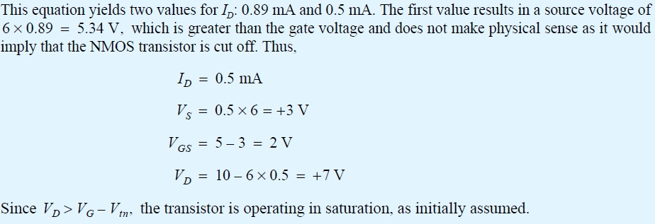
Example 3 – Sol, cont.

Slide 11
4.1. Obtaining a Voltage Amplifier
example of transconductance amplifier
Previously, we learned that voltage controlled current source (VCCS) can serve as transconductance amplifier.
Q: How can we translate current output to voltage?
A: Measure voltage drop across load resistor.
(Eq. 8)

Slide 12
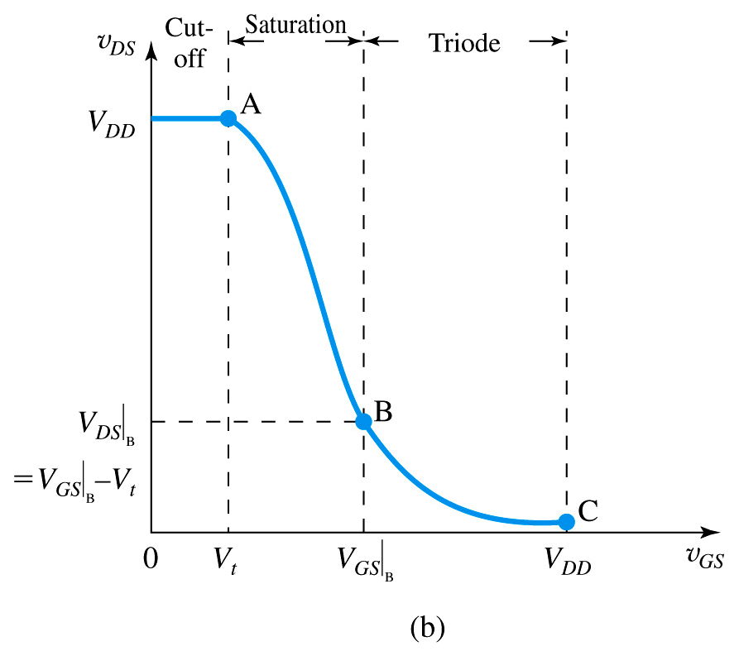
4.2. Voltage Transfer Characteristic
voltage transfer characteristics (VTC) – plot of out voltage vs. input
three regions exist in VTC
v_{GS} < V_{t} → cut off FET
v_{OV} = v_{GS} – V_{t} < 0
I_{D} = 0
v_{DS} ??? v_{OV}
v_{out} = v_{DD}
V_{t} < v_{GS} < v_{DS} + V_{t} → saturation
v_{OV} = v_{GS} – V_{t} > 0
I_{D} = ½ k_{n}(v_{GS} – V_{t})²
v_{DS} >> v_{OV}
v_{out} = V_{DD} – I_{D}R_{D}
v_{DS} + V_{t} < v_{GS} < V_{DD} → triode
v_{OV} = v_{GS} – V_{t} > 0
I_{D} = k_{n}(v_{GS} – V_{t} – v_{DS})v_{DS}
v_{DS} > v_{OV}
v_{out} = V_{DD} – I_{D}R_{D}
Figure 11: (b) the voltage transfer characteristic (VTC) of the amplifier from previous slide

Slide 13
4.2. Voltage Transfer Characteristic
Q: What observations may be drawn?
A: Cutoff MOSFET represents transistor blocking, cutoff AMP represents v_{out} = 0
A: As v_{GS} increases…
v_{DS} (effectively) decreases
i_{D} increases
v_{out} decreases nonlinearly
gain (G) decreases
Figure 11: (b) the voltage transfer characteristic (VTC) of the amplifier from previous slide

Slide 14
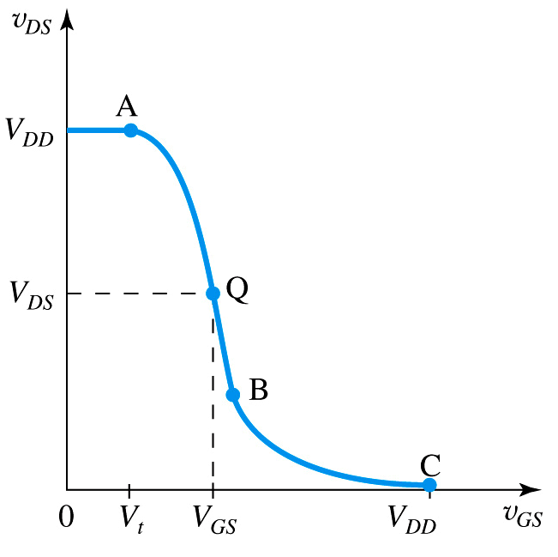
4.3. Biasing the MOSFET to Obtain Linear Amplification
(Eq. 9)
Q: How can we linearize VTC?
A: Appropriate biasing technique
A: Dc voltage v_{GS} is selected to obtain operation at point Q on segment AB
Q: How do we choose v_{GS}?
A: Will discuss shortly…
Figure 12: biasing the MOSFET amplifier at point Q located on segment AB of VTC

Slide 15
4.3. Biasing the MOSFET to Obtain Linear Amplification
(Eq. 9)
bias point / dc operating pt. (Q) – point of linearization for MOSFET
Also known as quiescent point.
Q: How will Q help us?
A: Because VTC is linear near Q, we may perform linear amplification of signal << V_{GSQ}
Figure 12: biasing the MOSFET amplifier at point Q located on segment AB of VTC

Slide 16
4.3. Biasing the MOSFET to Obtain Linear Amplification
Q: How is linear gain achieved?
step #1: Bias MOSFET with dc voltage V_{GS} as defined by (Eq. 10)
step #2: Superimpose amplifier input (v_{gs}) upon V_{GS}.
step #3: Resultant v_{ds} should be linearly proportional to small-signal component v_{gs}.

Slide 17
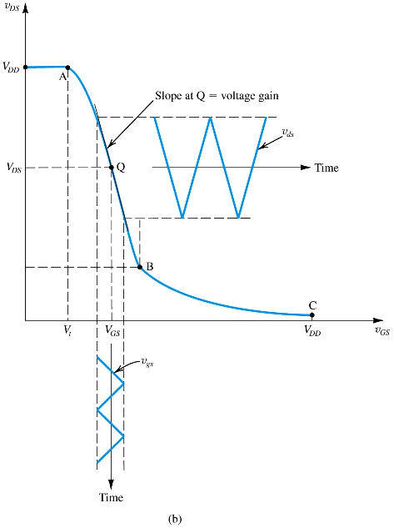
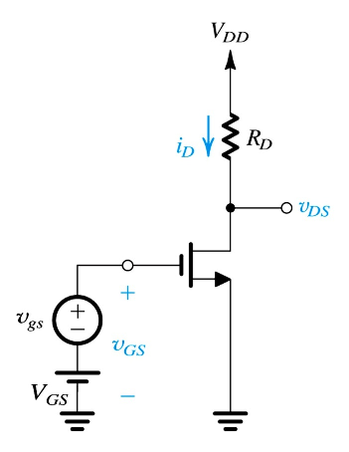
Q: How is linear gain achieved?
Figure 13: The MOSFET amplifier with a small time-varying signal v_{gs}(t) superimposed on the dc bias voltage v_{GS}. The MOSFET operates on a short almost-linear segment of the VTC around the bias point Q and provides an output voltage v_{ds} = A_{v}v_{gs}
As long as v_{gs}(t) is small, its effect on v_{DS}(t) will be linear – facilitating linear amplification.

Slide 18
Q: How is linear gain achieved?
step #4: Note if v_{gs} is small, output v_{ds} will be nearly linearly proportional to it.
Slope will be constant.
Eq. 9
(Eq. 10)

Slide 19
4.4. Small-Signal Voltage Gain
Q: What observations can be made about voltage gain?
A: Gain is negative.
A: Gain is proportional to:
load resistance (R_{D})
transistor conductance parameter (k_{n})
overdrive voltage (v_{OV})
Eq. 9
(Eq. 10)

Slide 20
4.4. Small-Signal Gain
Equation (11) is another version of (10).
It demonstrates that gain is ratio of:
voltage drop across R_{D}
half of over voltage
(Eq. 11)

Slide 21
Example 4: MOSFET Amplifier
Problem Statement: Consider the amplifier circuit shown in the figure. The transistor is specified to have V_{t} = 0.4V, k’_{n} = 0.4mA/V², W/L = 10, and λ = 0. Also, let V_{DD} = 1.8V, R_{D} = 17.5kOhms, and V_{GS} = 0.6V.
Q(a): For v_{gs} = 0 (and hence v_{ds} = 0), find V_{OV}, I_{D}, V_{DS}, and A_{v}.
Q(b): What is the maximum symmetrical signal swing allowed at the drain? Hence, find the maximum allowable amplitude of a sinusoidal v_{gs}.

Slide 22
Example 4 – Sol
Since $V_{DS}$ is greater than $V_{OV}$, the transistor is indeed operating in saturation. The voltage gain is given by

Slide 23
Example 4 – Sol, Cont.

Slide 24
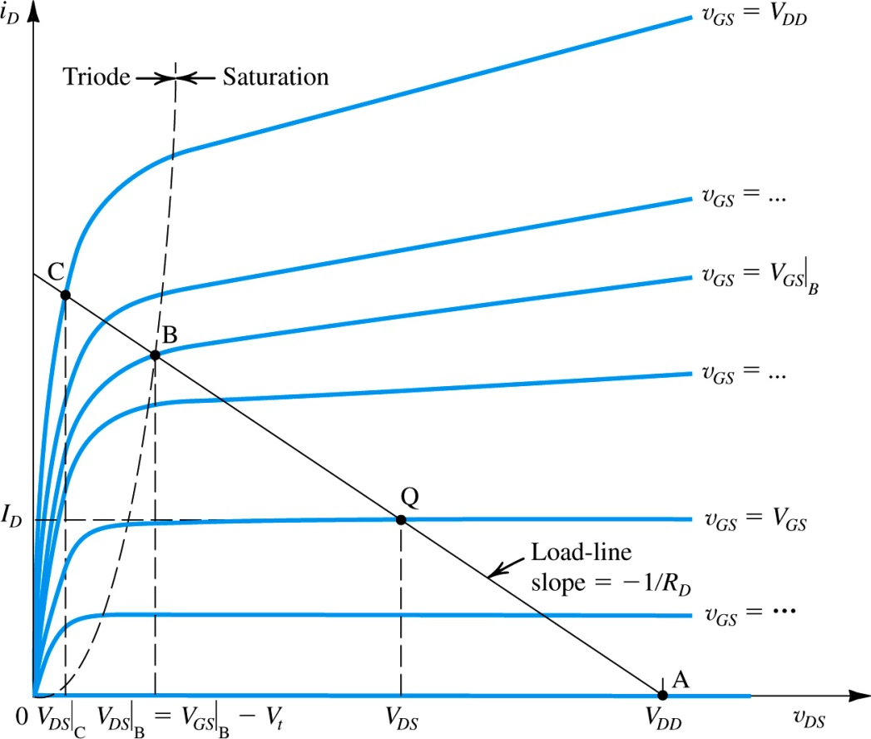
4.5. Determining the VTC via Graphical Analysis
(Eq. 12)
Graphical method for determining VTC is shown in Figure 31
Rarely used in practice, b/c difficult to draw vi-relationship.
Based on observation that, for each value of v_{GS}, circuit will operate at intersection of i_{D} and v_{DS}.
note: that slope of load line is dependent on -1/R_{D}
Figure 14: Graphical construction to determine the voltage transfer characteristic of the amplifier in Fig. 13.

Slide 25
4.5. Determining the VTC via Graphical Analysis
Points A (open) and C (closed) are suitable for switch applications
point A – where v_{GS} = V_{t}
point Q – where MOSFET may be biased for amplifier operation
v_{GS} = V_{GS}, v_{DS} = V_{DS}
point B – where MOSFET leaves saturation / enters triode
point C – where MOSFET is deep in triode region and v_{GS} = V_{DD}
Point Q is suitable for amplifier applications

Slide 26
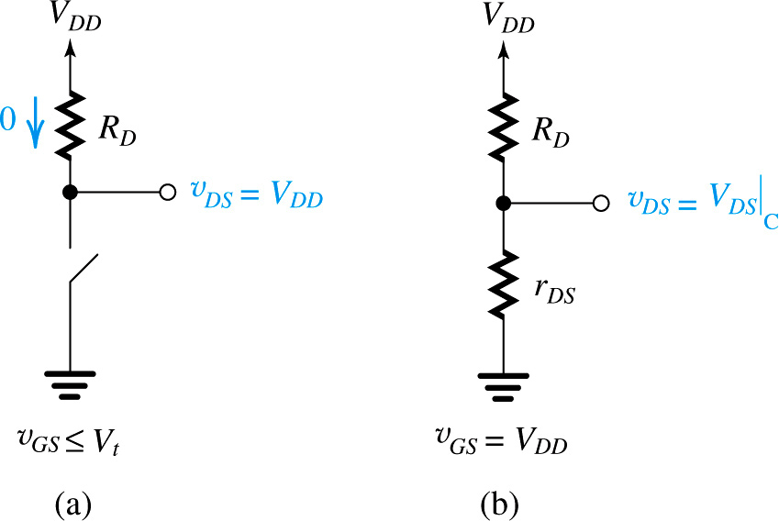
4.5. Determining the VTC via Graphical Analysis
Figure 15: Operation of the MOSFET in Figure 13 as a switch: (a) Open, corresponding to point A in Figure 14; (b) Closed, corresponding to point C in Figure 14. The closure resistance is approximately equal to r_{DS} because V_{DS} is usually very small.

Slide 27
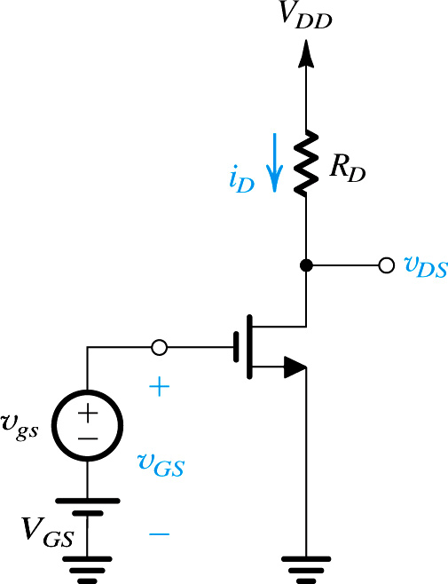
5. Small-Signal Operation and Models
input voltage to be amplified
dc bias voltage
output voltage
Previously it was stated that linear amplification may be obtained from MOSFET via…
Operation in saturation region
Utilization of small-input
This section will explore small-signal operation in detail
Note the conceptual amplifier circuit to right
Figure 16: Conceptual circuit utilized to study the operation of the MOSFET as a small-signal amplifier.

Slide 28
5.1. The DC Bias Point
Q: How is dc bias current I_{D} defined?
Figure 16: Conceptual circuit utilized to study the operation of the MOSFET as a small-signal amplifier.

Slide 29
5.2. The Signal Current in the Drain Terminal
Q: What is effect of v_{gs} on i_{D}?
step #1: Define v_{GS} as in (5.42).
step #2: Define i_{D}, separate terms as function of V_{GS} and v_{gs}

Slide 30
Q: What is effect of v_{gs} on i_{D}?
Note that to minimize nonlinear distortion, v_{gs} should be kept small.
½k_{n}v_{gs}² << k_{n}(V_{GS}-V_{t})v_{gs}
v_{gs} << 2(V_{GS}-V_{t})
v_{gs} << 2v_{OV}
step #3: Classify terms.
dc bias current (I_{D}).
linear gain – is desirable.
nonlinear distortion – is undesirable, because rep. distortion.

Slide 31
Q: What is effect of v_{gs} on i_{D}?
step #4: Adapt (5.43) for small-signal condition.
If v_{gs} << 2v_{OV} , neglect distortion.

Slide 32
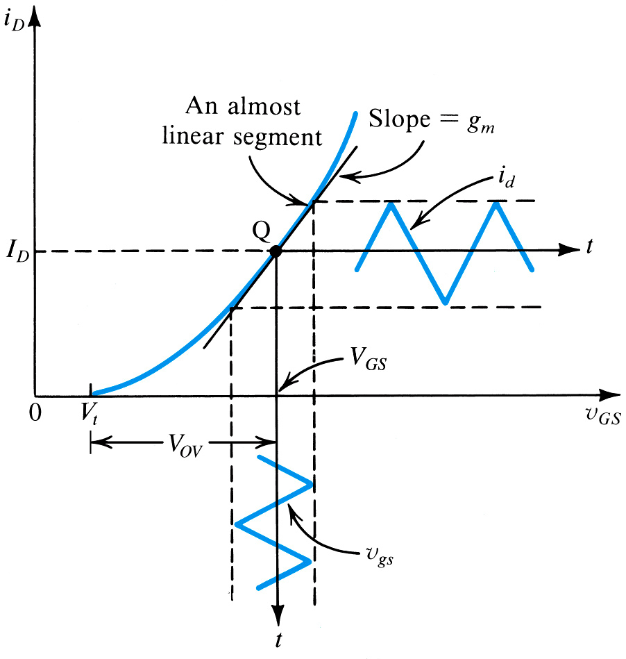
Figure 17: Small-signal operation of the MOSFET amplifier.

Slide 33
5.3. The Voltage Gain
Q: How is voltage gain (A_{v}) defined?
step #1: Define v_{DS} for circuit of Figure 34 using KVL.
Figure 16: Conceptual circuit utilized to study the operation of the MOSFET as a small-signal amplifier.

Slide 34
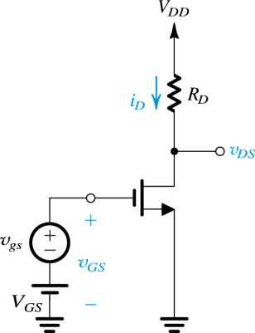
Q: How is voltage gain (A_{v}) defined?
step #2: Isolate v_{ds} component of v_{DS}.
step #3: Solve for gain (A_{v}).
(Eq. 13)
Figure 16: Conceptual circuit utilized to study the operation of the MOSFET as a small-signal amplifier.

Slide 35
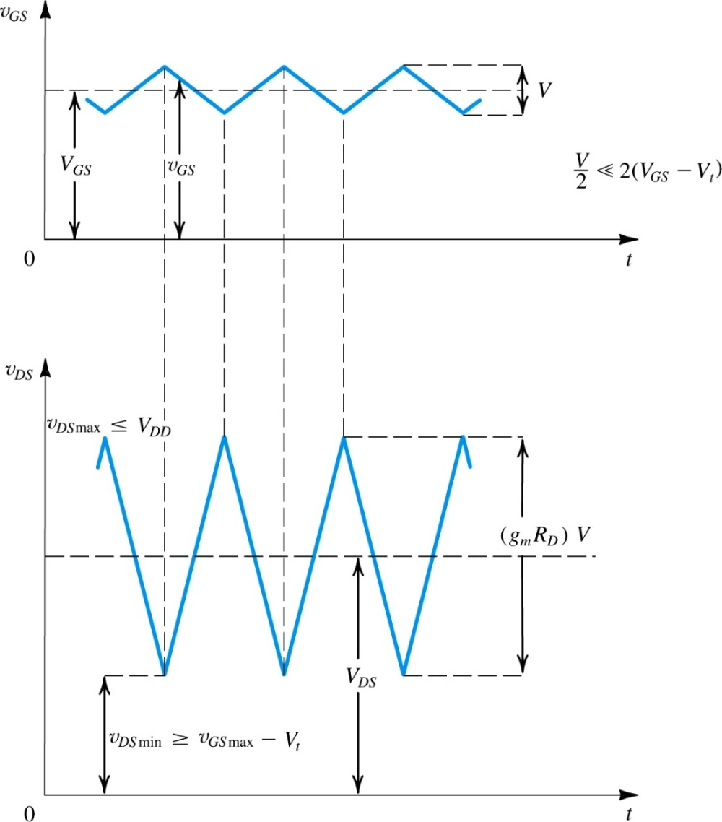
5.3. The Voltage Gain
Output signal is shifted from input by 180^{O}.
Input signal v_{gs} << 2(V_{GS} – V_{t}).
Operation should remain in MOSFET saturation region
v_{DS} > v_{GS} – V_{t} (legroom)
v_{DS} < V_{DD} (headroom)
Figure 18: Total instantaneous voltage v_{GS} and v_{DS} for the circuit in Figure 5.34.

Slide 36
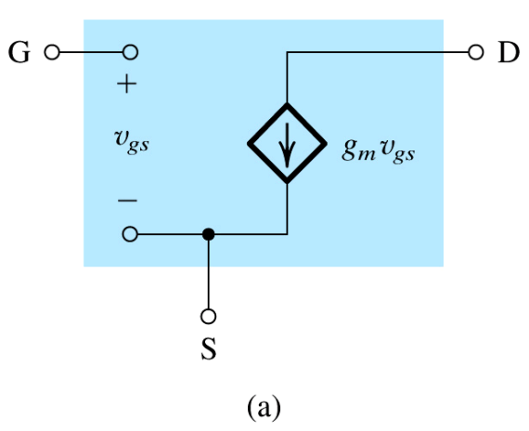
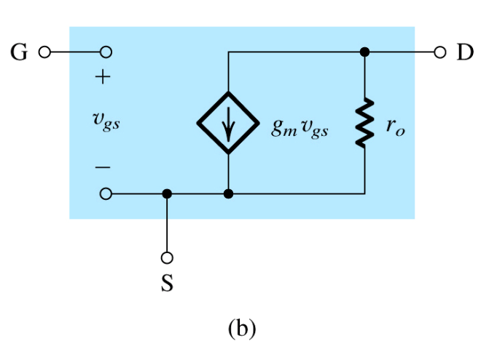
5.5. Small-Signal Equivalent Models
From signal POV, FET behaves as VCCS.
Accepts v_{gs} between gate and source
Provides current (i_{D}) at drain
Input resistance is high
b/c gate terminal draws i_{G} = 0
Output resistance is high
Figure 19: Small-signal models for the MOSFET: (a) neglecting the dependence of i_{D} on v_{DS} in saturation (the channel-length modulation effect) and (b) including the effect of channel length modulation

Slide 37
5.5. Small-Signal Equivalent Models
Note that this resistor (r_{o}) takes on value 10kOhm to 1MOhm and represents channel-length modulation.
Figure 19: Small-signal models for the MOSFET: (a) neglecting the dependence of i_{D} on v_{DS} in saturation (the channel-length modulation effect) and (b) including the effect of channel length modulation

Slide 38
More Observations
Model (b) is more accurate than model (a)
r_{o} = V_{A} / I_{D}
Small signal parameters (g_{m}, r_{o}) both depend on dc bias point
If channel-length modulation is considered, (Eq. 14) becomes (Eq. 15).
(Eq. 14)
(Eq. 15)

Slide 39
5.6: The Transconductance g_{m}
In summary, there are three relationships for determining g_{m}
These relationships are dependent on three design parameters:
W/L, V_{OV}, I_{D}
$$g_{m}=k_{n}V_{OV}$$
$$g_{m}=\sqrt{2k_{n}I_{D}}$$
$$g_{m}=\frac{2I_{D}}{V_{OV}}$$

Slide 40
Example 5: MOSFET Amplifier
Problem Statement: Figure 20 shows a discrete common-source MOSFET amplifier utilizing a drain-to-gate resistance R_{G} for biasing purposes. The input signal v_{I} is coupled to the gate via a large capacitor, and the output signal at the drain is coupled to the load resistance R_{L} via another large capacitor. The transistor has V_{t} = 1.5V, k’_{n}(W/L) = 0.25mA/V², and V_{A} = 50V. Assume the coupling capacitors to be sufficiently large so as to act as short circuits at the signal-frequencies of interest.
Q: We wish to analyze this amplifier circuit to determine its (a) small-signal voltage gain, its (b) input resistance, and the largest allowable input signal.

Slide 41
note: capacitors block dc signals completely, but have no effect on small-signal
Figure 20: Example 5 amplifier circuit.

Slide 42
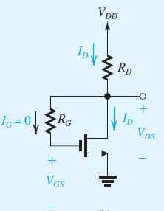
Example 5 – Sol
We first determine the dc operating point.
1- DC analysis: as shown in the figure
We note that since $I_{G}=0$, the dc voltage drop across $R_{G}$ will be zero, and
$$V_{DS}>V_{OV}$$
Solving the resulting quadratic equation in $I_{D}$ and discarding the root that is not physically meaningful yields the solution

Slide 43
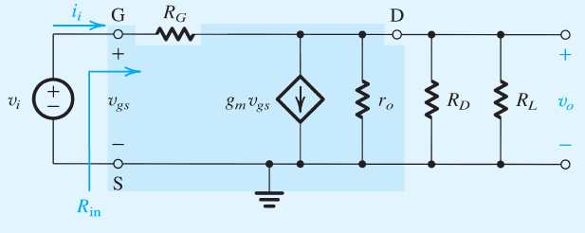
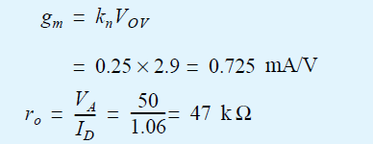
Example 5 – Sol, Cont.
Next we proceed with the small-signal analysis of the amplifier.
The values of the transistor small-signal parameters g_{m} and r_{o} can be determined by using the dc bias quantities found above,

Slide 44
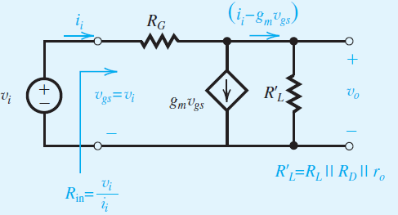
Example 5 – Sol, Cont.
Toward that end we simplify the circuit by combining the three parallel resistances $r_{o}$, $R_{D}$, $R_{L}$and in a single resistance ${R′}_{L}$,
→ (1)
→ (2)

Slide 45
Example 5 – Sol, Cont.
Substituting for $i_{i}$ from Eq. (2) into Eq. (1) results in the following expression for the voltage gain:
To obtain the input resistance, we substitute in Eq. (1) for $v_{o}=A_{v}v_{\text{gs}}=−{\text{g}}_{m}R_{L}^{′}v_{\text{gs}}$, then use $R_{in}=v_{i}/i_{i}$ to obtain
which is still very large.

Slide 46
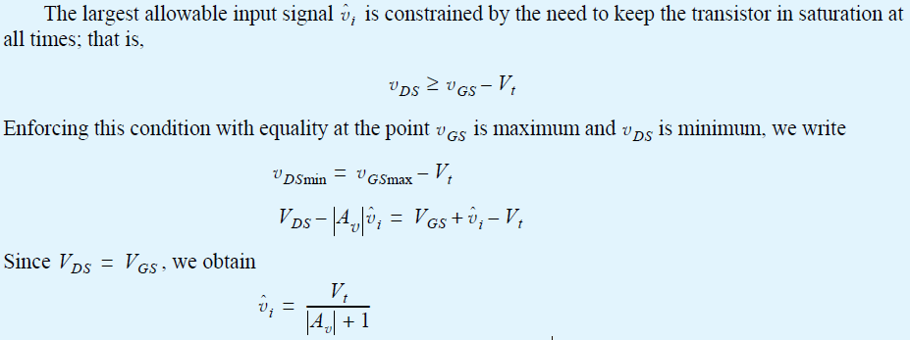
Example 5 – Sol, Cont.

Slide 47
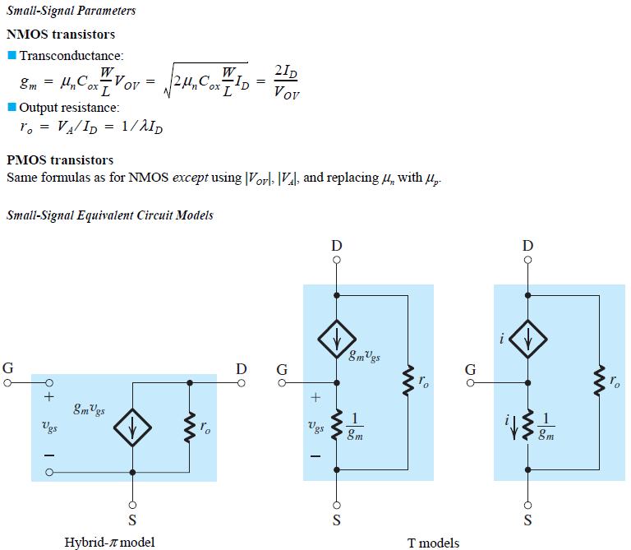

Slide 48
Summary
The enhancement-type MOSFET is current the most widely used semiconductor device. It is the basis of CMOS technology, which is the most popular IC fabrication technology at this time. CMOS provides both n-channel (NMOS) and p-channel (PMOS) transistors, which increases design flexibility. The minimum MOSFET channel length achievable with a given CMOS process is used to characterize the process
The overdrive voltage |V_{OV}| = |V_{GS}| - |V_{t}| is the key quantity that governs the operation of the MOSFET. For amplifier applications, the MOSFET must operate in the saturation region.

Slide 49
Summary
In saturation, i_{D} shows some linear dependence on v_{DS} as a result of the change in channel length. This channel-length modulation phenomenon becomes more pronounced as L decreases. It is modeled by ascribing an output resistance r_{o} = |V_{A}|/I_{D} to the MOSFET model. Although the effect of ro on the operation of discrete-circuit MOS amplifiers is small, that is not the case in IC amplifiers.
The essence of the use of MOSFET as an amplifier is that in saturation v_{GS} controls i_{D} in the manner of a voltage-controller current source. When the device is dc biased in the saturation region, a small-signal input (v_{gs}) may be amplified linearly.
In cases where a resistance is connected in series with the source lead of the MOSFET, the T model is the most convenient to use.

